Slide 1
Salesforce Spring Release 23
February 2nd, 2023

Slide 2
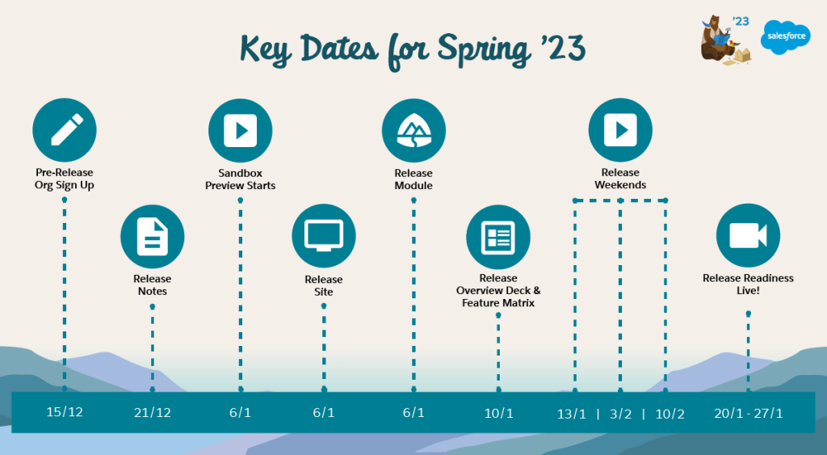
Key Dates for Spring 23 Release

Slide 3
General Enhancements
Be Ready for MFA:
As of February 1, 2022, users are contractually required to use multi-factor authentication (MFA) when they access Salesforce orgs, either through direct logins with a username and password or single sign-on (SSO) logins.
Major Release Notification Emails Are Streamlined
To reduce the number of emails that you receive, the Release Is Live email is updated, and the Features Enabled email is discontinued.
Limit the Maximum Number of Loaded Lightning Console Tabs in a Session
By default, content is loaded in all console tabs opened during a Lightning console session. To improve memory usage and the scalability of console sessions in Lightning Experience, set the maximum number of loaded console tabs.
Log In with More Domain Formats
Enhanced domains and partitioned domains change the format of the login URLs for your Salesforce org and your sites.

Slide 4
Reports and Dashboards
Create Personalized Report Filters
Set up a single dynamic report filter that displays personalized results for each user. For example, create an opportunity report for your sales team with a single Opportunity Owner filter that personalizes the results for each member of the team.
Stay Informed on Dashboard and Report Subscriptions
You’re no longer in the dark about which reports, dashboards, or other analytic assets your users are subscribed to. Manage data access by determining what kind of attachments are sent, who receives them, and who the running user is. Stay on top of scheduling and limits with a quick report showing when subscriptions run and who set them up. Create a custom report type on Analytic Notifications to view the source, owner, running user, and schedule of subscriptions.
Subscribe to More Reports and Dashboards
Get more actionable reports and dashboards delivered to your inbox on schedule and with the latest data. Each user in an Unlimited Edition org can now subscribe to up to 15 reports and 15 dashboards. The previous limit was 7 reports and 7 dashboards.

Slide 5
Reports and Dashboards
Stay in Lightning Experience When Editing Lightning Reports
The Lightning Report Builder now has all the features of Salesforce Classic, so you don’t need to go back to Classic to access certain features. To help you remember, we removed the Edit in Classic button from the Row Level Actions menu on the Lightning Reports page.
Stay Organized by Adding Reports and Dashboards to Collections (Beta)
Use collections to organize the reports and dashboards that you care about, even if they exist in multiple folders. Add Lightning reports and dashboards, such as those related to a project or commonly used, for immediate access in Unified Home. Pin important collections to your home page, hide irrelevant collections, and share collections with others.
Facet SOQL Queries on Related Salesforce Objects with Ease
Surfacing trends between Salesforce objects with parent-child relationships is now easier. For example, you can track related opportunities and cases without code on a dashboard set up to monitor Salesforce account records. Parent-child faceting between steps built on Salesforce objects is enabled by default on new dashboards.

Slide 6
Salesforce Flow Orchestrator Enhancements:
1.Use Advanced Settings for an Orchestration: –
Exercise more control over the usage and execution of your orchestration with advanced settings.
You can also turn your orchestration into a template and use it as a starting point for creating other orchestrations in Flow Builder.
2.Enable Sharing for Flow Orchestration Objects (Release Update): –
After Enable Sharing for Flow Orchestration Objects is selected, the Manage Flow user permission no longer grants users access to
Flow Orchestration objects. The Manage Orchestration Runs and Work Items user permission, along with sharing rules and role hierarchies,
control user access to Flow Orchestration objects. Users who run orchestrations and execute work items must still have the Run Flows user permission.
3.Create a Record-Triggered Orchestration on the Core Tab: –
Want to create a record-triggered orchestration go to the Core tab in the New Flow window to get started.

Slide 7
Salesforce Flow Enhancements:
Bring External Data into Flow Builder Without Code (Beta)
Build Screens with Interactive Components (Beta)
Add Lookup Fields to Your Flow Screens with Ease
See Element Descriptions on the Flow Canvas
Select a Value from a List of Choices with the Choice Lookup Component (Beta)
Use Flow Screen Components with Flow in Slack (Generally Available)
Use More Flow Elements: – The limit of 2000 flow elements was removed. Other limits still apply.

Slide 8
Features for Developer
1.Manage and Release Changes with DevOps Center (Generally Available): –
Salesforce DevOps Center provides an improved experience around change and release management that brings DevOps best practices to your development team, regardless of where team members fall on the low-code to pro-code spectrum. All developers and builders can work together to deliver value to customers in a repeatable and scalable way.
2.Use Lightning Web Security Enablement for Orgs with No Custom Components: –
Lightning Web Security (LWS) for Lightning web components (GA) and LWS for Aura (beta) is enabled by default for orgs that don’t contain custom Lightning web components or Aura components. If your org has no custom components, this enablement has no impact unless you subsequently add Lightning web components or Aura components.
lockerServiceNext:
"settings": {
"securitySettings": {
"sessionSettings": {
"lockerServiceNext": false
}
}
}

Slide 9
Features for Developer
3.Query DOM Elements with Refs: –
Now you can use refs to access elements in shadow DOM and light DOM. Refs locate DOM elements without a selector and only query elements
contained in a specified template. Previously, you could only use querySelector() to locate specific DOM elements.
First, add the lwc:ref directive to your element and assign it a value.
To call that reference, use this.refs. In this example, the <div> element has the directive lwc:ref="myDiv",
which this.refs references to access the <div> at runtime.
<template>
<div lwc:ref="myDiv"></div>
</template>
export default class extends LightningElement {
renderedCallback() {
console.log(this.refs.myDiv);
}
}

Slide 10
Features for Developer
4.Use the Improved Conditional Directives:
The lwc:if, lwc:elseif, and lwc:else conditional directives supersede the legacy if:true and if:else directives.
5.View Debug Information for Your Wired Properties:
Access debug information for wired properties and methods on a component via custom formatters in Chrome DevTools.
6.Synchronize Component Data Without a Page Refresh Using RefreshView API (Beta):
Whether user-driven or app-invoked, the ability to synchronize data without reloading an entire page is a key user experience requirement.
The new lightning/refresh module and RefreshView API provide a standard way to refresh component data in LWC and Aura.
7.Find Which Apex Classes Implement an Interface (Generally Available): –
ApexTypeImplementor is now generally available and is updated since the beta release.
Use the object to find Apex classes that directly or indirectly implement an interface.

Slide 11
Features for Developer
8.Use the System.enqueueJob Method to Specify a Delay in Scheduling Queueable Jobs:
Using the System.enqueue(queueable, delay) method ignores any org-wide enqueue delay setting.
9. Pass Bind Variables to a SOQL Query:
Use the new getSObjectType() method to get the SObjectType of a Schema.DescribeFieldResult object. The returned type is that of the source sObject
describe object that was originally retrieved, eliminating the need for additional mechanisms to determine parent relationships.
10.Discover the Source SObject of a DescribeFieldResult Instance:
Whether user-driven or app-invoked, the ability to synchronize data without reloading an entire page is a key user experience requirement. The new lightning/refresh module and RefreshView API provide a standard way to refresh component data in LWC and Aura.
11.Restrict Anonymous Apex Access to Core Users:
By using the RestrictCommunityExecAnon preference, admins can restrict anonymous Apex execution to core users, such as Standard and CsnOnly users. When enabled, noncore users can’t execute anonymous Apex regardless of any other user permissions that are set, such as Author Apex. Noncore users include these user types: PowerPartner, Partner, PowerCustomerSuccess, Guest, and CSPLitePortal.

Slide 12
Features for Developer
12.Choose Any Name for a Global Value Set:
When you create a custom global value set in API version 57.0 or later, the developer name is appended with the suffix __gvs. You can now create a global value set with any name that doesn’t conflict with a standard entity of the same name.
13.Limit User Profile Access for Packages Installed via Metadata API:
When you use Metadata API to install a managed package, you can specify which user profiles in the org can access the package. Use the new securityType field on the InstalledPackage metadata type, and select either all users or admins only. If a security type isn’t specified, the default behavior provides access to the package to all user profiles in the org.

Slide 13
Beta and pilot features:
Configure Searchable Fields for Each User Profile (Beta):
Enhance Lightning Dashboards with Text and Graphics (Beta):
Recalculate Account Sharing Rules Faster (Beta):
Approve Content and Create Workflows in Enhanced CMS Workspaces (Beta):
Focus Your View with More Dashboard Filters (Beta):
Fetch Data Using the GraphQL Wire Adapter (Pilot):
Increase Case Resolution with Einstein Search Answers (Pilot):

